Slide 1
pHps2 (250 → 150 bp) pCM66T

Slide 2
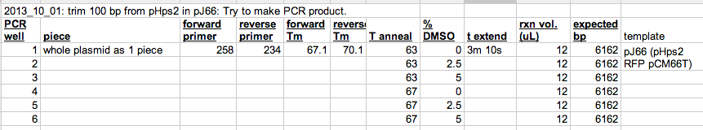
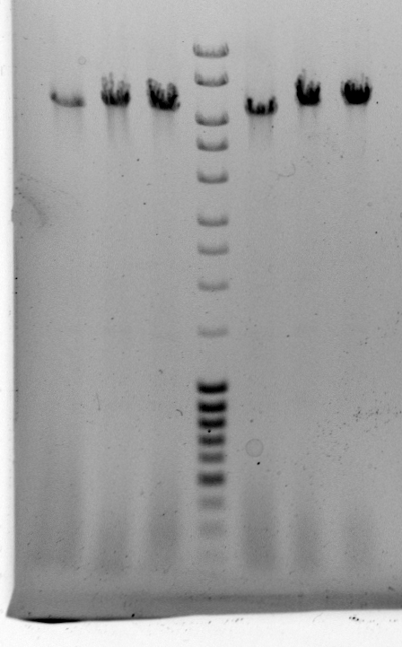
Do 40 uL of well 6

Slide 3
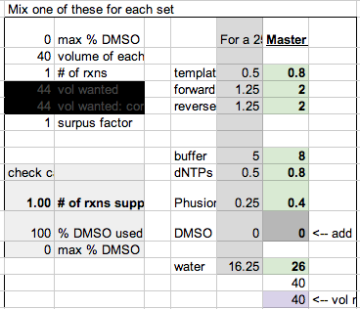
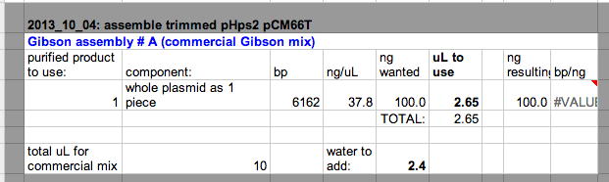
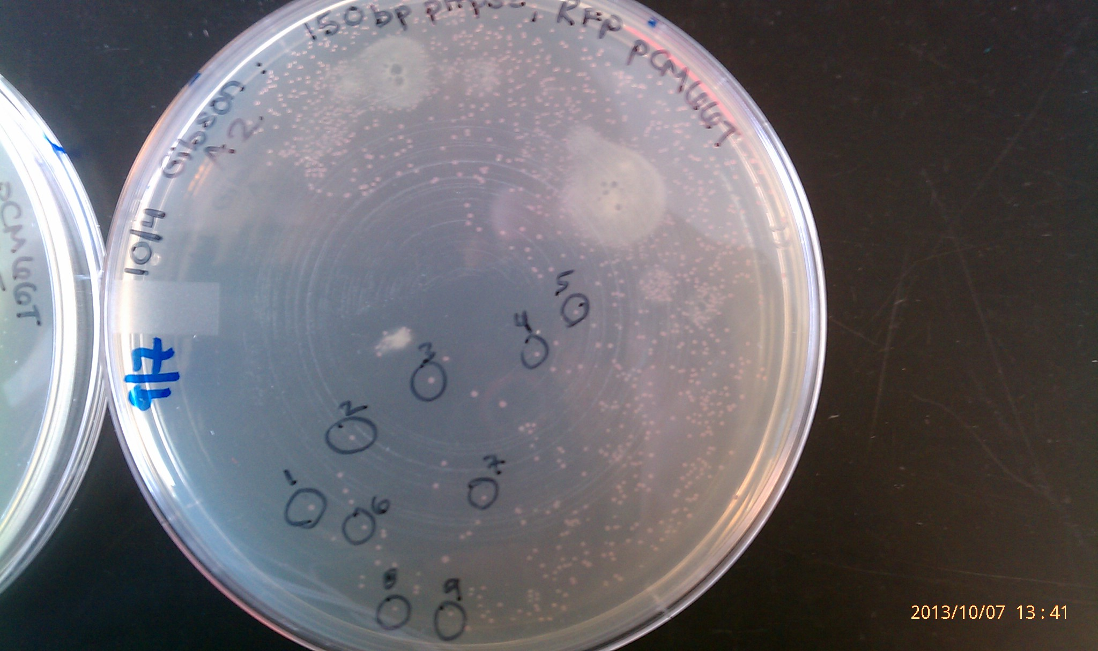

Slide 4
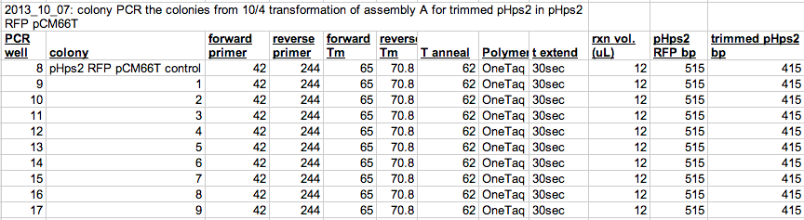
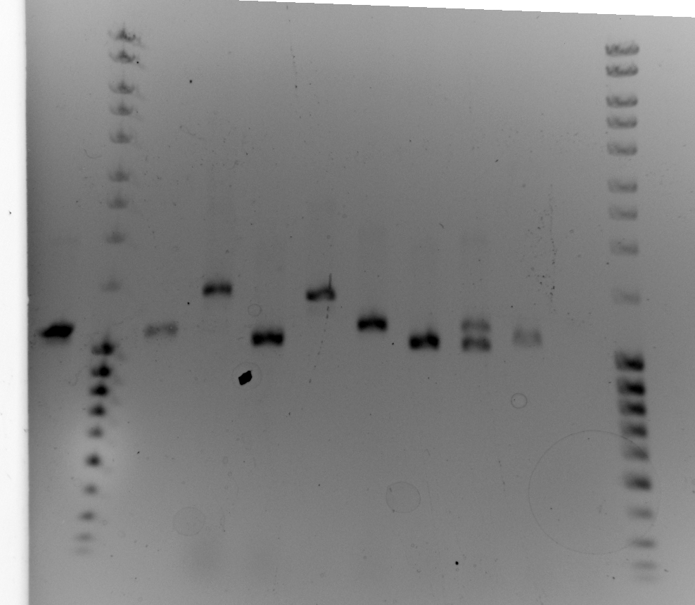
Accidentally did primers 42 & 212. pHps2 RFP pCM66T template = 1150 bp.
Desired plasmid = 1050 bp.
The line is 1031. I can’t see if an =y are close & I ran it too long before I thought to take a 2nd pic.
This is a bit subtle… Can I really tell the difference on this gel?
Actions:
Restreak #s 1, 3, 6, and some I haven’t colony PCRed yet. Give the new ones numbers 10 – 22.

Slide 5
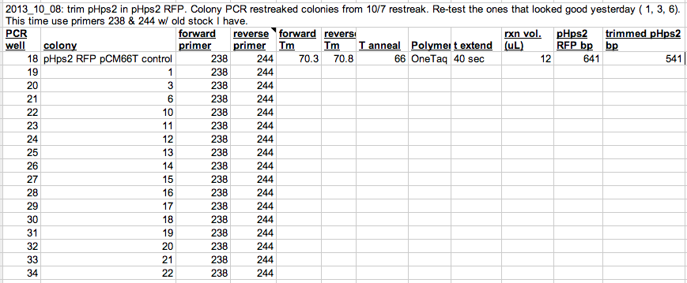
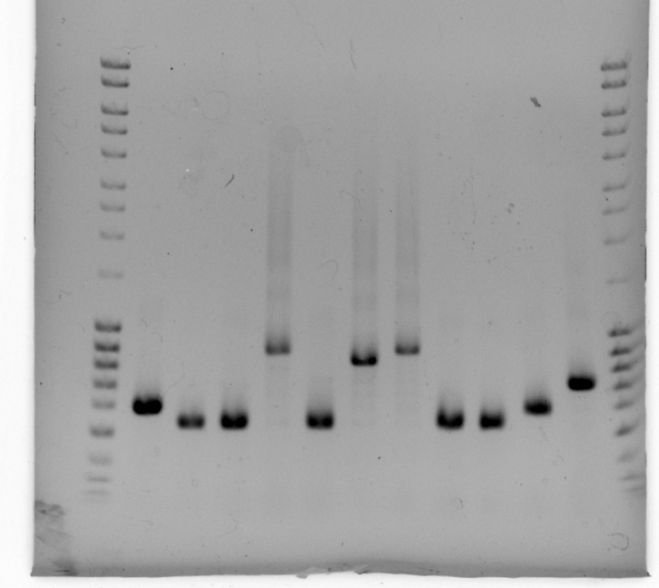
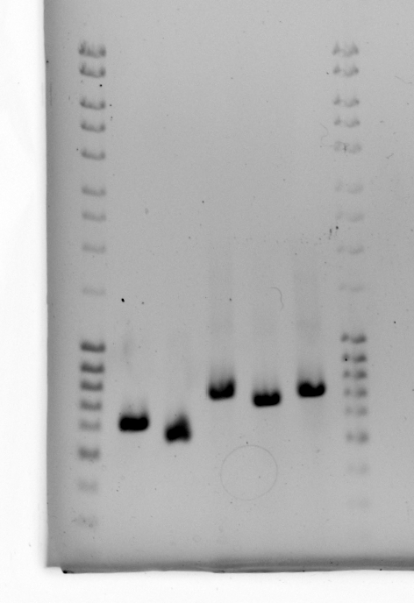
Not sure why pHps2 RFP plasmid control didn’t amplify… not enough template??
Inoculate #s 3, 6, 11.
Restreak #s 14, 15, 19 on new plate
pHps2 RFP pCM66T control
18
19
20
21
22
1031
1
3
6
11
14
15
16
1031
800
800
*
*
*
*
*
600
*
600
1

Slide 6
Colonies looked good.
Committed.

